Slide 1

What do we mean by ‘development’?
An agricultural economic perspective
on rural transformation
Chris Barrett
Guest Lecture to
GDEV 4140/PLSCI 4140/5140
Global Cropping Systems and Sustainable Development
February 5, 2026

Slide 2
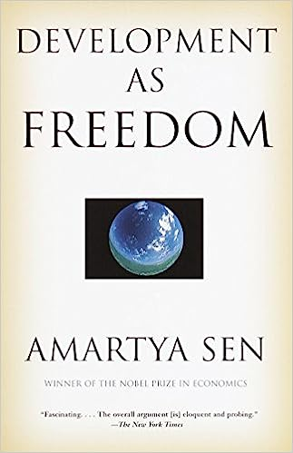
What is dev’t? Sen
Development = freedom to achieve well-being.
Well-being reflects individuals’ ‘capabilities’ and ‘functionings’.
Capabilities = the doings and beings (e.g., well-nourished, educated, married, travel) people can achieve if they so choose.
Functionings = realized capabilities.

Slide 3
What is dev’t?
Capabilities/options are hard to measure.
So rely on functionings by appeal to ‘revealed preference’. How can/do we measure ‘functionings’?
Many unidimensional measures exist: food security, income, educational attainment, life expectancy.
Curse of dimensionality!
Some multidimensional approaches exist. They’re complicated and require arbitrary index measures.
So we use best proxy measure: income/expenditures

Slide 4
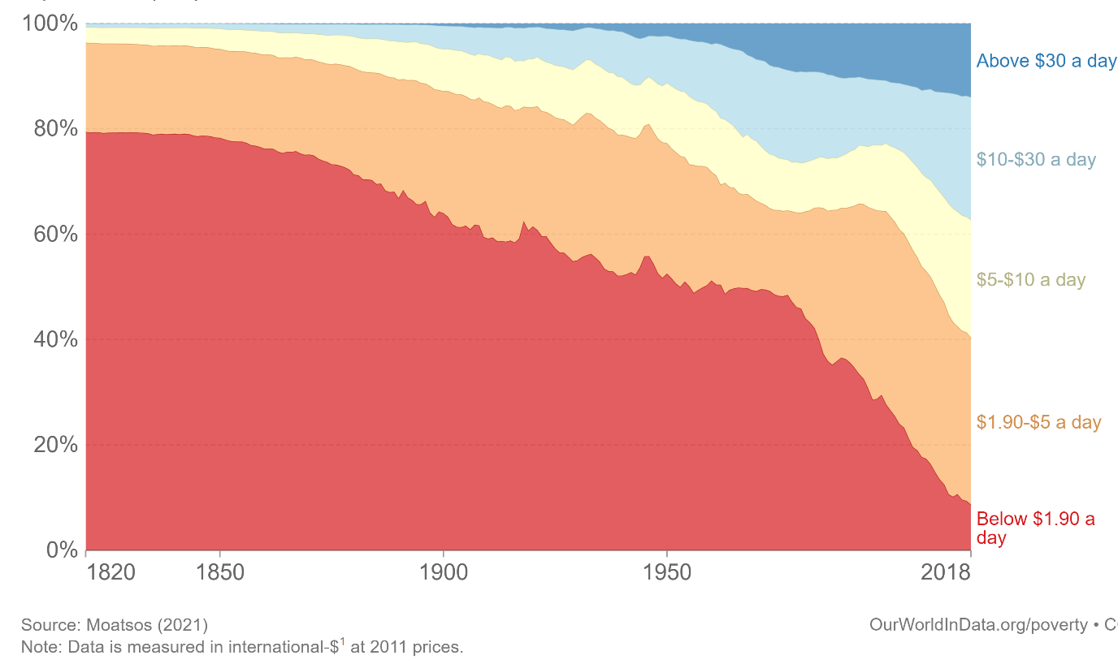
What is dev’t?
By that measure, the world has done really well over my life time! ☺
Evolution of global (income/expenditure-based) poverty over time

Slide 5
Why does ag tech change matter to development?
Ag technological change especially important
“Most of the people in the world are poor, so if we knew the economics of being poor we would know much of the economics that really matters. Most of the world’s poor people earn their living from agriculture, so if we knew the economics of agriculture we would know much of the economics of being poor.”
- Theodore W. Schultz
Opening sentences of 1979 Nobel Prize in Economics lecture

Slide 6
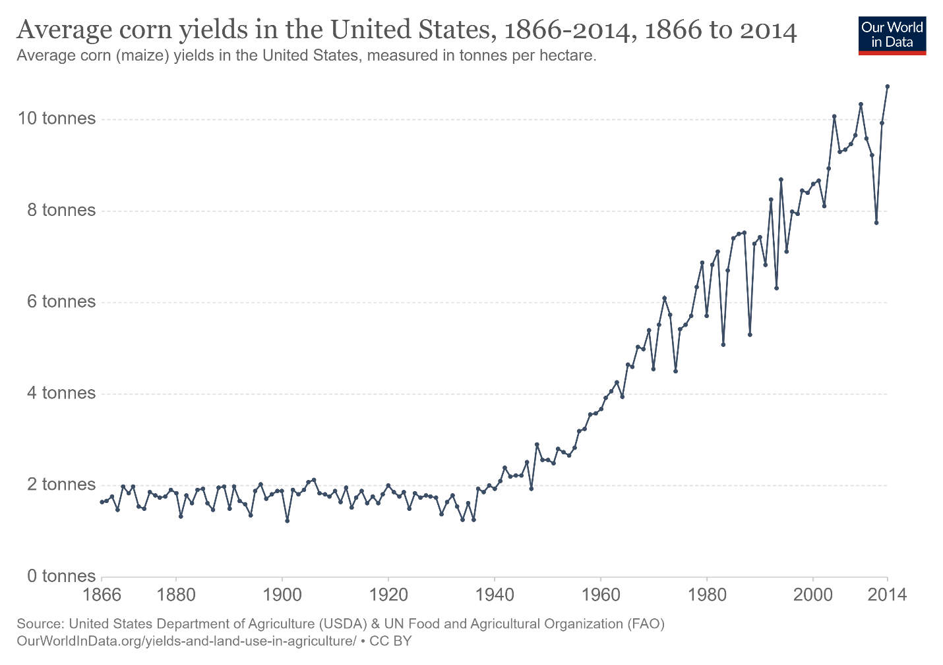
85-90 yrs ago, we faced Global Depression, Dust Bowl in US. Ag R&E, “New Deal” programs (and WWII) sparked innovation to boost crop yields and reduce hunger … and launched a period of unprecedented agri-prosperity in today’s HICs.
Why does ag tech change matter?

Slide 7
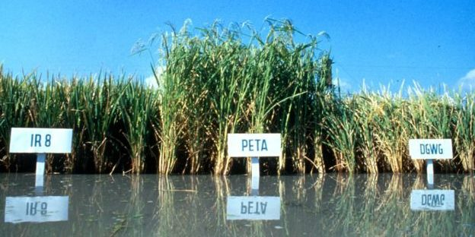
50-60 yrs ago, facing ‘population bomb’ and recurring famines in Asia/Africa, goal was again to reduce hunger/raise yields. Science-led effort led to Green Revolution (Norman Borlaug 1970 NPP!) … policies/institutions also crucial (e.g., in China)
Why does ag tech change matter?
Photo credit: IRRI

Slide 8
Why does ag tech change matter?
What spurs agr. income growth?
Three possible sources of agricultural growth:
Increased use of inputs (land, water, labor, capital) brings more output, but typically at diminishing rate. Implies reduced marginal returns to labor (i.e., lower real wages and higher poverty) and environmental degradation (X⁰ to X¹).
Increased efficiency in using existing inputs and technologies, commonly through extension (Y⁰ to Y¹). But Schultz’s (1964) “poor but efficient” hypothesis suggests limits to this option.
Technological change to increase output potential given same inputs. Requires innovation, diffusion and farmer adaptation to change. Main long-term source of productivity/income growth for sustainable poverty reduction.
Output
New Production Possibility
Production Possibility
Y¹
Y⁰
Input
X⁰
X¹

Slide 9

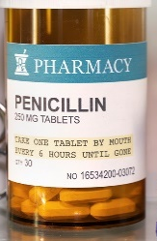
How tech change?
Sources of technological change (innovation)
Induced innovation model: private agents innovate so as to conserve relatively scarce/dear factors and to increase relatively valuable outputs. So ‘factor bias’ in tech change varies by region/crop/era (Hayami & Ruttan).
Strategically targeted investments by not-for-profit donors and governments: CGIAR, GAVI, etc.
Serendipity
Empirical evidence: induced innovation most important. B/c II turns on price signals, easily distorted by policies. Pro-poor innovations undervalued, hence the need for #s 2/3 plus benevolent patent extensions … see Sep. 2023 Nature paper).

Slide 10
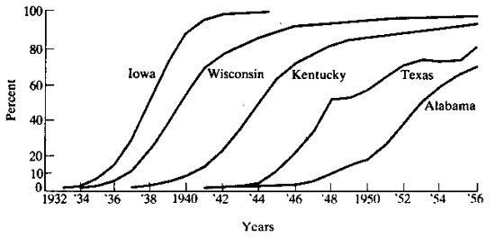
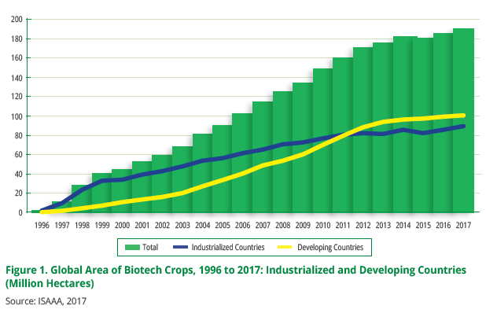
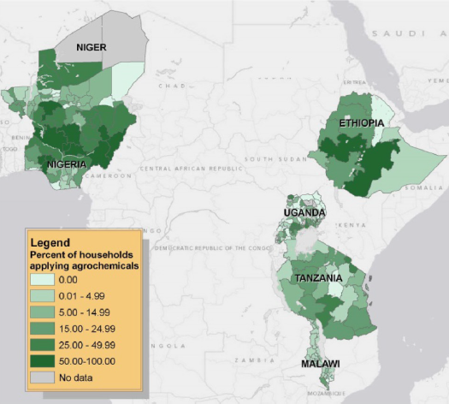
How tech change?
Diffusion of innovations
Standard diffusion pattern is logistic …
(Griliches, Econometrica, 1957 on hybrid corn diffusion in the US)
Rapid diffusion of GM crops worldwide … fastest ag innovation diffusion in history!
Varies a lot among/within countries
Sheahan and Barrett, Food Policy 2017

Slide 11
Who gains and why?
“Technology treadmill” and gains from change
Naïve model
If demand is perfectly elastic, gains accrue to producers.
But when, if ever, does this really happen?
Small-scale change: early adopters (who?)
Perfect market integration … export surplus production
New Supply
Price
Original Supply
Demand
P
Producer
Surplus
Added Producer
Surplus
Quantity

Slide 12
Who gains and why?
“Technology treadmill” and gains from change
Irony: big winners from most ag tech change are typically consumers not producers. Why?
Price
More realistic model
Price inelastic demand.
Fallacy of composition: what’s true at small scale (tech. change profitable for first few adopters) not true at large scale.
Hence tech treadmill
Demand
New Supply
Original Supply
Consumer
Surplus
P ^{old}
Old Producer
Surplus
New Consumer
Surplus
P ^{new}
New Producer
Surplus
Quantity

Slide 13
Who gains and why?
So how does ag tech change matter?
Increase farm profits, at least for early adopters: Those with best access to ICT, extension, credit/insurance, input and output markets, etc. These farmers gain from yield increases, cost reductions, or both.
Boost rural labor demand: Rural poor typically work off-farm (at least part-time). Enjoy labor market gains, both through more hours worked and higher real wages.
Reduce food prices: If enough adoption, aggregate supply shifts and prices fall (by how much depends on integration with national and global markets). Poor usually net food consumers who gain.
Result: Broad-based but uneven and evolving gains

Slide 14
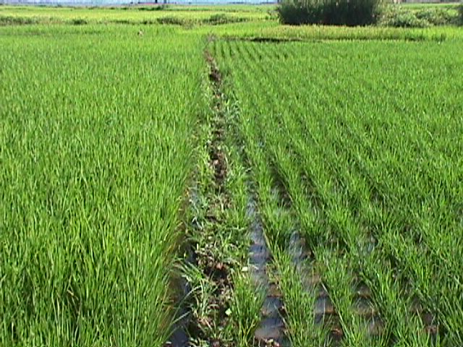
Who gains and why?
Adding it all up … an example from Madagascar:
A doubling of rice yields:
reduces the share of food insecure
households by 38%
shortens the average hungry period
by 1.7 months (1/3)
increases real unskilled wages in
lean season by 89 % (due to both
price and labor demand effects)
All the poor benefit: unskilled
workers, consumers, and net seller producers
… the poorest gain most.
(Source: Minten and Barrett, World Development, 2008).

Slide 15
Implications
“Technology treadmill” and gains from change
Some key policy implications
Extension
Essential to complement discovery and diffuse innovations faster and more equitably.
Intellectual Property
What differences emerge from open source/public licensing vs. private IP?
How does the income/wealth of target consumers influence induced innovation?
Financing
Who should pay for R&D? How does it depend on IP?

Slide 16

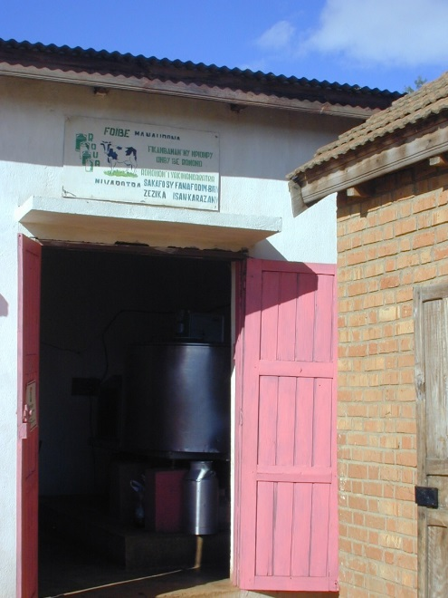
Questions?

